Slide 1
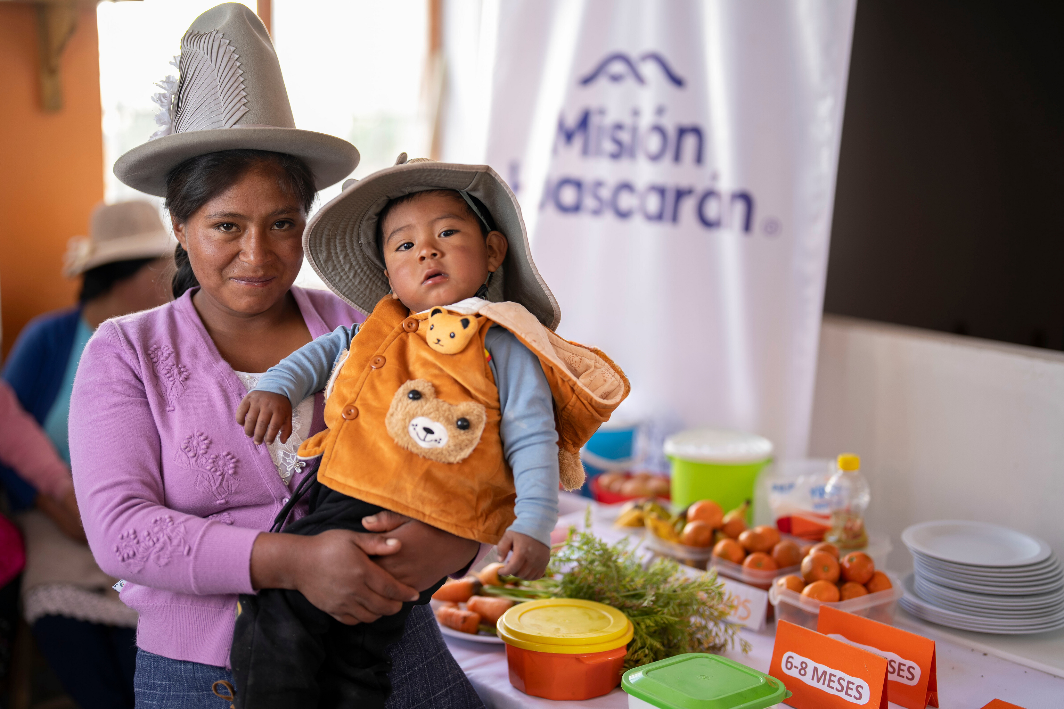


We empower rural communities to
improve their quality of life and promote their development

Slide 2





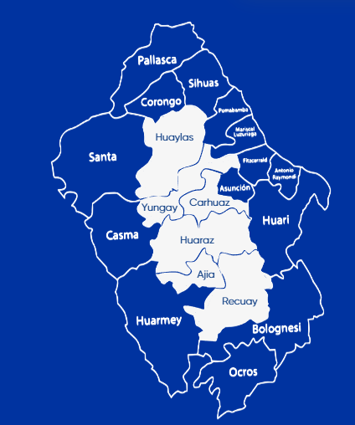




Where we are?
We are located in Peru
WHAT IS OUR PURPOSE?
We promote the integral development of more than 45,000 people across six provinces in the iconic Callejón de Huaylas, located over 3,500 meters above sea level in the Áncash region: Huaylas, Yungay, Carhuaz, Huaraz, Aija y Recuay.
Our commitment
To empower rural communities to improve their quality of life and promote sustainable development.
We do this through our integrated social programs:
In the Ancash province
In the ´Callejón de Huaylas´
NUTRITION
HEALTHCARE
EDUCATION

Slide 3

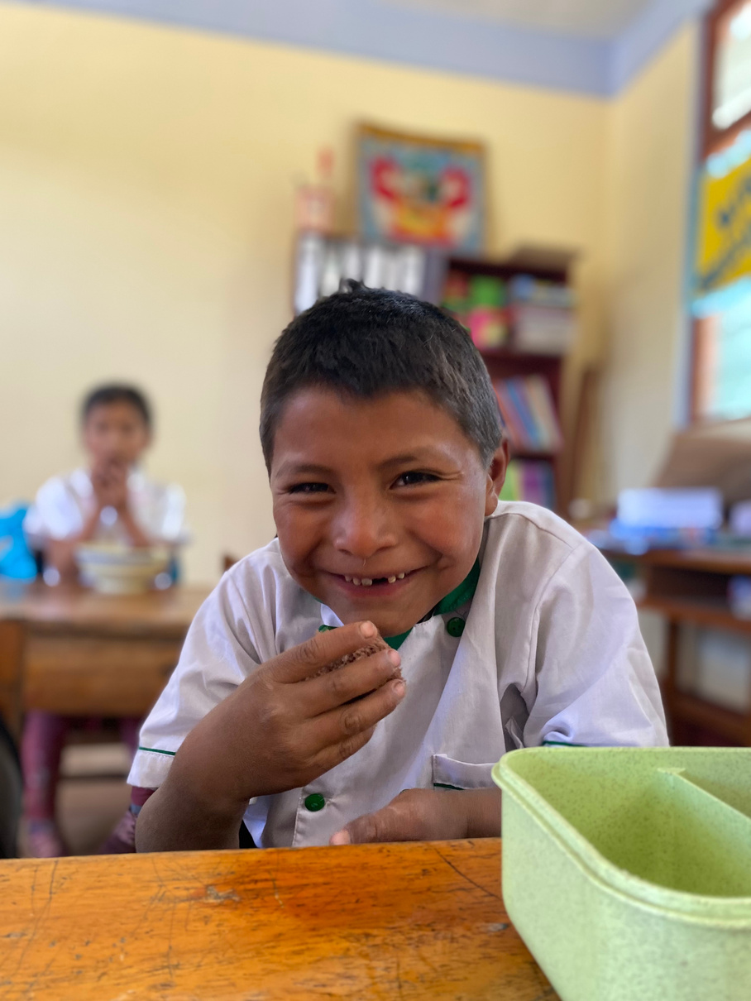
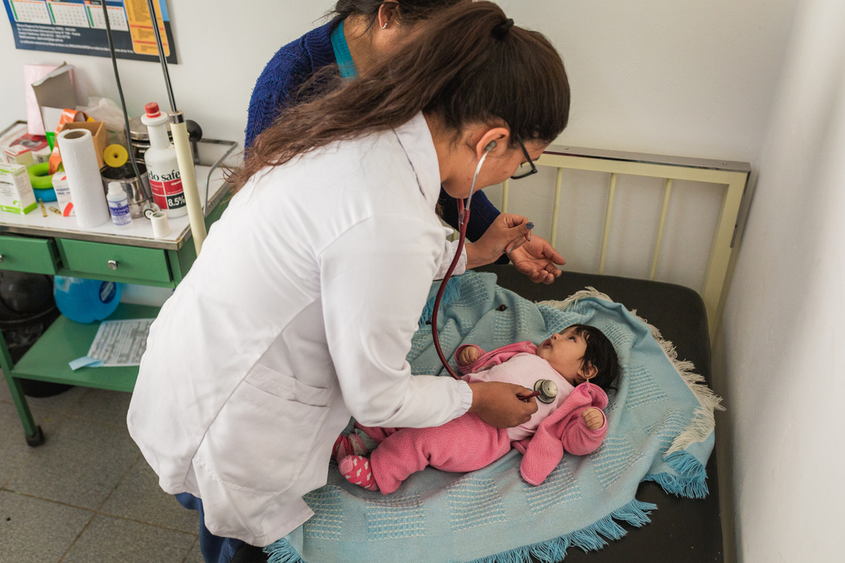
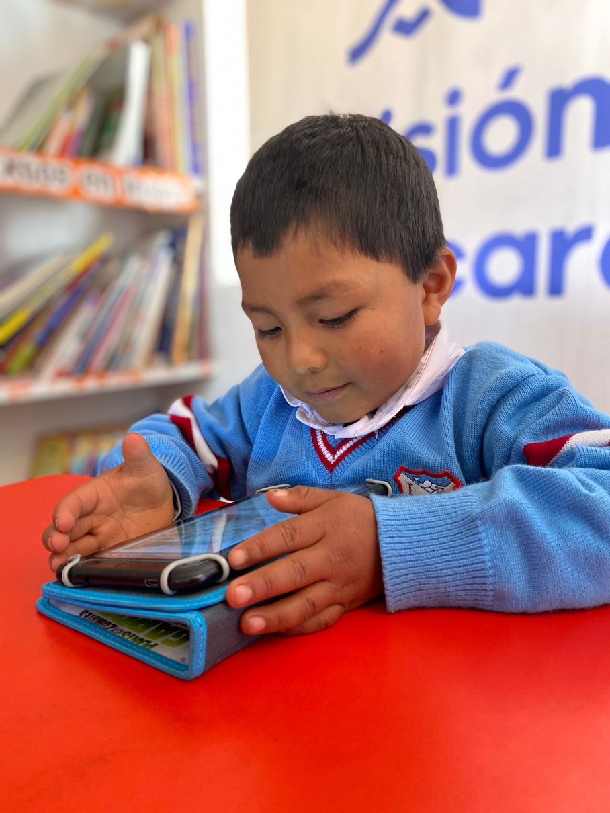



HOW DO WE DO IT?
NUTRITION
HEALTHCARE
EDUCATION
We combat childhood anemia and chronic malnutrition in over 25,000 beneficiaries, including children under 3 years old, pregnant women, and school-aged children.
By creating access to health services with our two mobile medical clinics, we reach more than 200 rural and remote communities in the Peruvian Andes.
We aim to help reduce illiteracy and strengthen reading comprehension through critical thinking, using playful libraries that inspire children to play, learn, and be creative in an experiential and imaginative way.

Slide 4

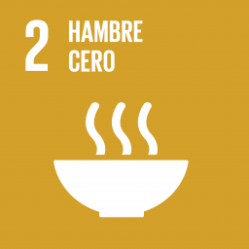



Social Programs
PROGRAMS ALIGNED WITH SDGS
NUTRITION
HEALTH
EDUCATION

Slide 5
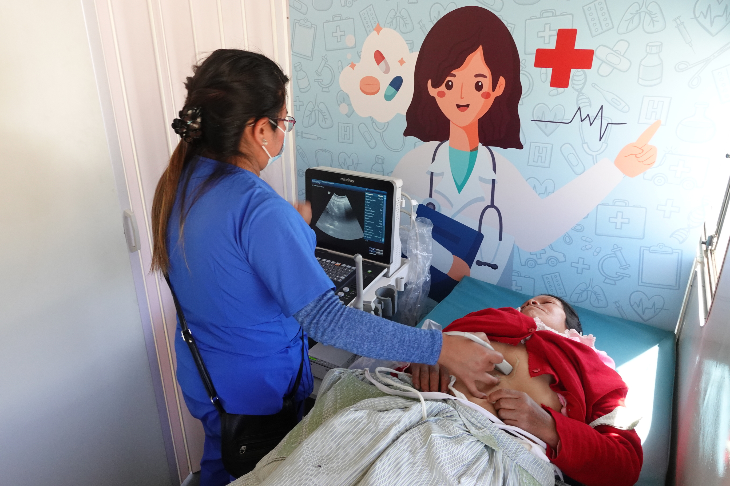
HEALTHCAREPROGRAM

Slide 6





Health Program Salud
WHAT DO WE DO?
HOW WE COLLABORATE?
We deliver quality medical care to more than 200 remote communities throughout the Callejón de Huaylas with:
We have 3 active inter-institutional agreements in place through 2026
Nutritionists
DIRESA ANCASH
Regional Health Authority of Ancash
RED DE SALUD HUAYLAS NORTE
RED DE SALUD HUAYLAS SUR
Mobile Medical Posts
The Mobile Medical Units (MMUs) are equipped with:
Thanks to coordinated efforts with local authorities at various levels, we are able to provide comprehensive assistance:
PMM 1
PMM 2
Medical campaigns with healthcare professionals
Receiving medications from the pharmaceutical industry
1 general medicine consultation room 1 dental consultation room 1 fully equipped dental chair
1 pediatric consultation room 1 gynecology consultation room 1 portable ultrasound machine

Slide 7

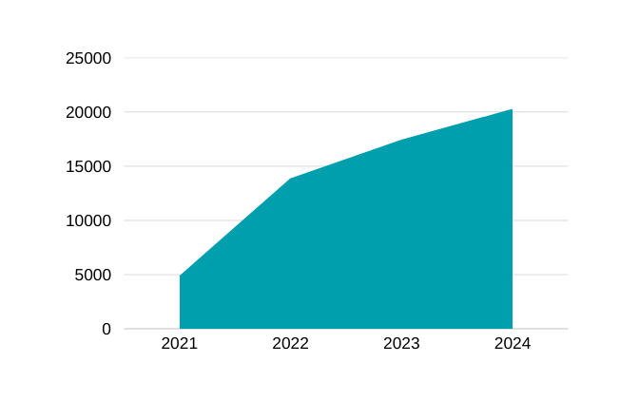


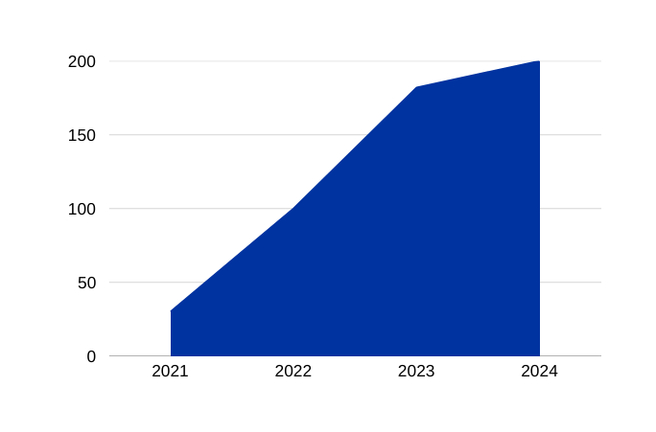
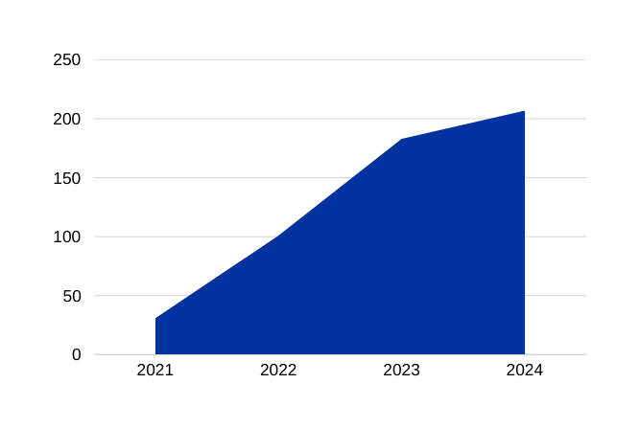



LOGROS Y METAS
Health Program
ACHIEVEMENTS
Evolución de atenciones médicas gratuitas
Evolution of free medical consults
Impact Metrics 2024
20,206
17,365
20,206
17,365
13,800
4,800
13,800
Medical consults
Medical volunteers
4,800
4,800
20,206
+1,000
Evolución de comunidades atendidas
Evolution of attended rural communities
200
182
206
182
Medical campaigns
Ultrasounds
100
91
868
100
30
30

Slide 8
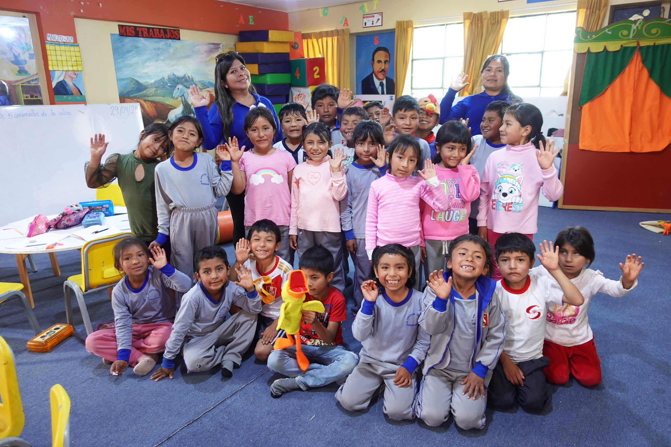
EDUCATION PROGRAM

Slide 9






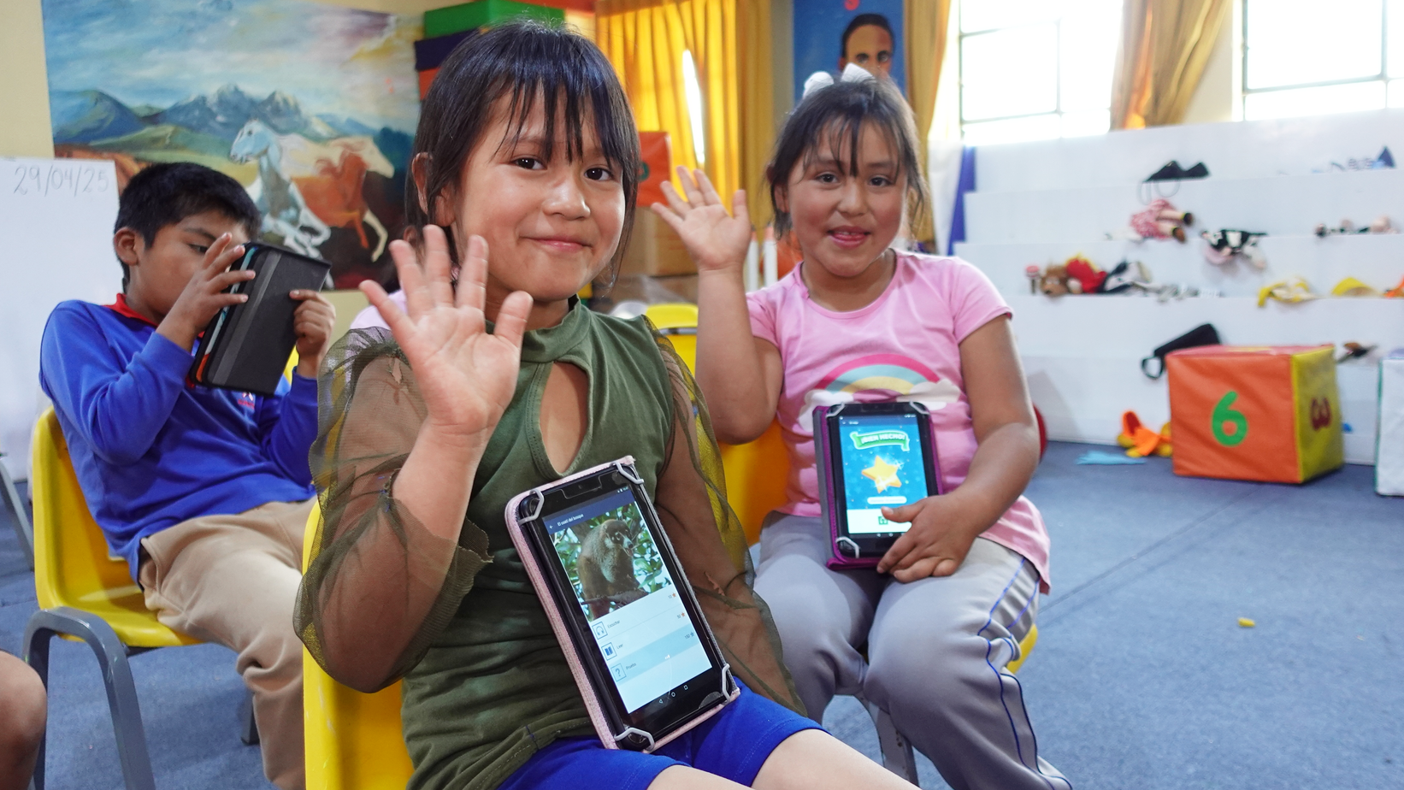
Education Program
WHAT DO WE DO?
THE EDUCATIONAL STRATEGY CONTAINS:
WE TRANSFORM THE EDUCATION
We seek to contribute to reducing illiteracy rates in the schools where we work and to strengthen reading comprehension skills by developing students' critical thinking.
All of this takes place in playful library environments that serve as experiential learning spaces for students—where they are encouraged and inspired to play, learn, and be creative in new and imaginative ways.
Currently, we reach 325 students.
Group Activity
EducationActivity
Individual Reading
Tecnologícal APPs
Free Playing Time
WE PROMOTE READING COMPREHENSION
We use Raz-Plus, a globally recognized platform known for its educational quality in developing reading comprehension.

Slide 10

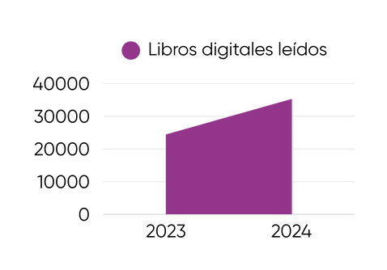


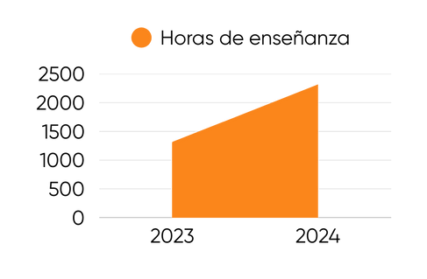


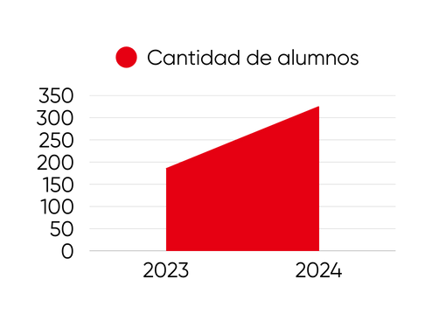
LOGROS Y METAS
Education Program
ACHIEVEMENTS
Evolución de atenciones médicas gratuitas
Digital Books Read
Impact Metrics 2024
35,179
24,300
20,206
17,365
13,800
4,800
4,800
NUMBER OF SCHOOLS
BOOKS READ
Teaching Hours
From 6 to 8
35,179
2,309
4,800
Evolución de comunidades atendidas
1,306
200
182
Number of Students
100
TEACHING HOURS
PROGRAM ASSITANCE
325
2,309
89%
30
185

Slide 11
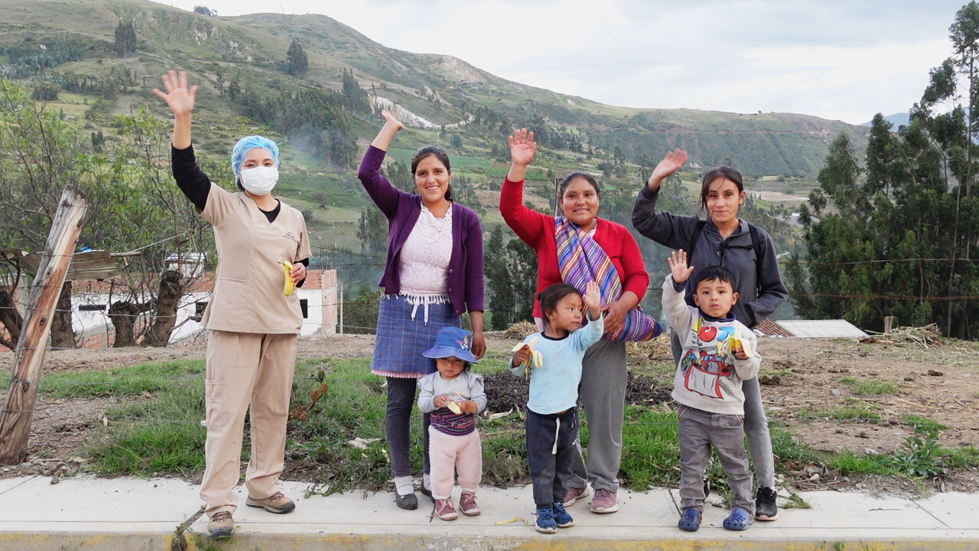
NUTRITION PROGRAM

Slide 12

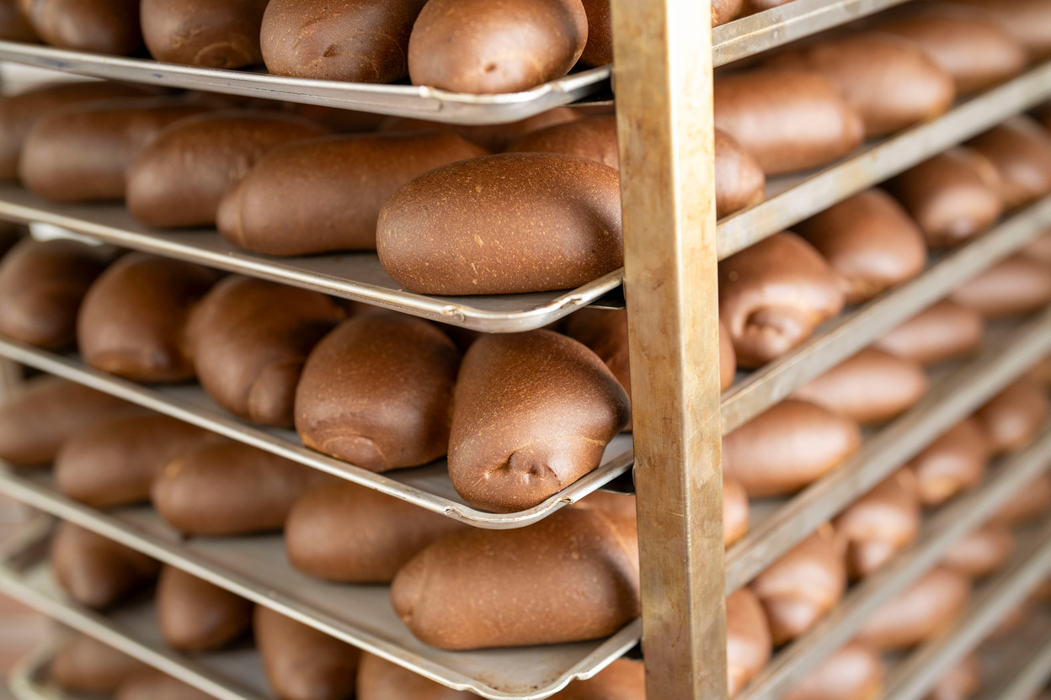
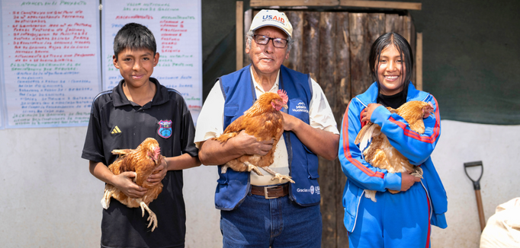
Nutrition Program
5 PILLARS OF OUR INTERVENTION MODEL
5) Female Leaders
1) Food Fortification
1) Food Fortificaction
Anemia Zero
Fortification of bread with heme iron.
It covers between 60 to 90% of the Daily Iron Requirement in a child.
The portion is 2 breads daily for 6 days a week.
The delivery is made to 793 beneficiaries.
4) Nutritional Education
2) Food Security
3) Access to Clean and Secure Water
2) Food Security
Installation of Family and School Bio-gardens.
Installation of Community Chicken Coops.
Availability of nutritious and safe foods (Fish, milk, eggs, and vegetables).
Technical support
+ 25 thousand beneficiaries:
Women of childbearing age, pregnant women, infants, schoolchildren, and adolescents.

Slide 13
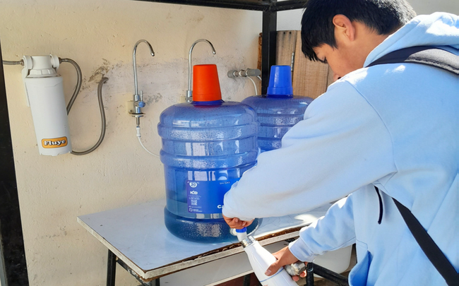
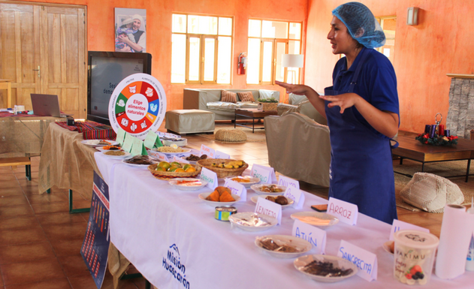
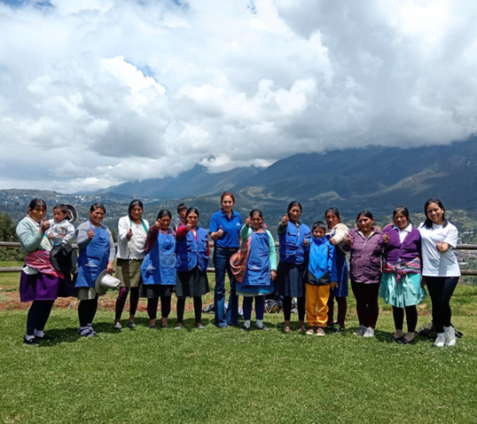
5 pilares of our Intervention Model
3) Access to Clean and Secure Water
4) Nutritional Education
Installation of water filter system.
Deworming campaigns.
Training for Community Leaders on clean water and parasites.
Distribution of sustainable water bottles
Directed to communities and schools:
Educational talks
Interactive workshops
Demonstration sessions
Nutritional counseling
Home visits
Compliance evaluation
5) Female Leaders
Recruitment of volunteer mothers.
Training on health, nutrition, leadership, and empowerment topics.
Assignment of tasks related to the Nutrition Program.
They are ‘Community Agents.

Slide 14





Nutrition Program
LOGROS Y METAS
Impact Metrics 2024
ACHIEVEMENTS
Evolución de atenciones médicas gratuitas
Evolution of Prevalence of Anemia and treated population 019 - 2024
1000
20,206
50%
312,385
34
17,365
900
17,365
45%
800
13,800
40%
Nutritional Complementation with Heminic Bread
Metric Tonnes of Frozen Fish
700
4,800
13,800
35%
600
4,800
30%
500
4,800
25%
4,800
400
20%
300
15%
200
Evolución de comunidades atendidas
10%
100
5%
0
200
0
2019
2020
2021
2022
2023
2024
182
200
182
Treated Population
Prevalence of Anemia
4,800
19,587
Milk products donated
Free-range Egg Production

Slide 15









Nutrition Program
Impact Metrics 2024
28
40
76
252
Educational Talks
Nutritional Coaching
Playful Workshop
Home Visits
228
7
31
11
Familty Vegetable Gardens
School Vegetable Gardens
Female Leaders
Water Filters

Slide 16























The Social Programs of Misión Huascarán operate thanks to:
Nutrition:
Education:
Healthcare:

Slide 17







